Slide 1
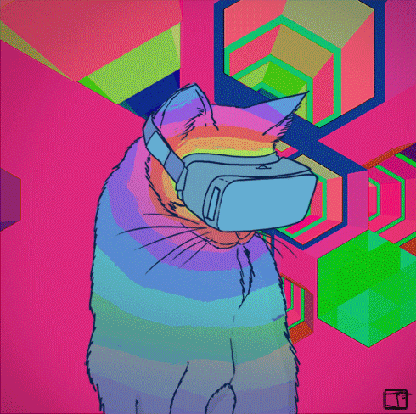
A New Reality Workshop
Alex Mackey
Lars Klint
Patrick Catanzariti

Slide 2
Workshop Agenda
Developing 3D/VR experiences with Web Tech
Intro to A-Frame
MR.JS/continue with A-Frame

Slide 3
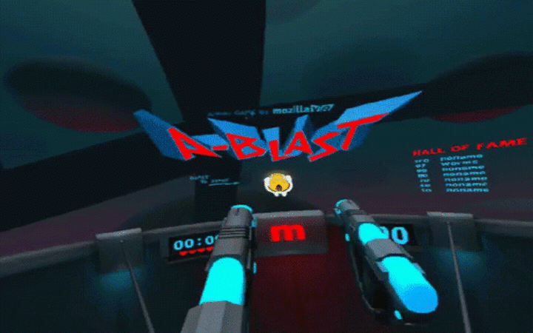
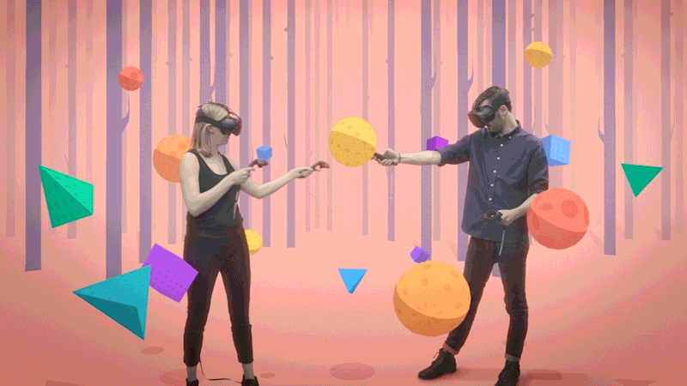
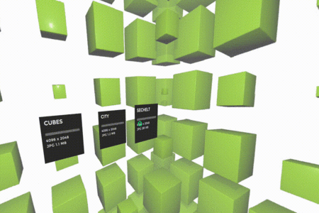
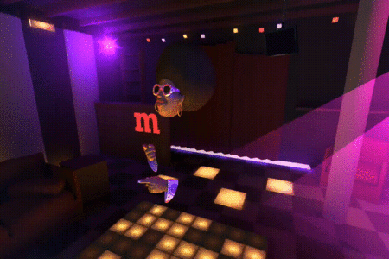

Slide 4
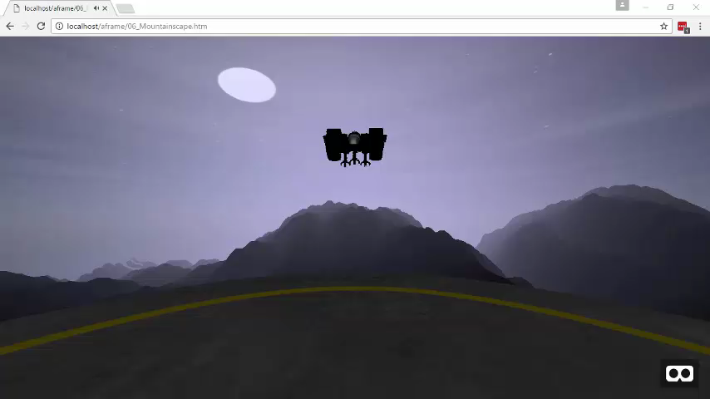

Slide 5
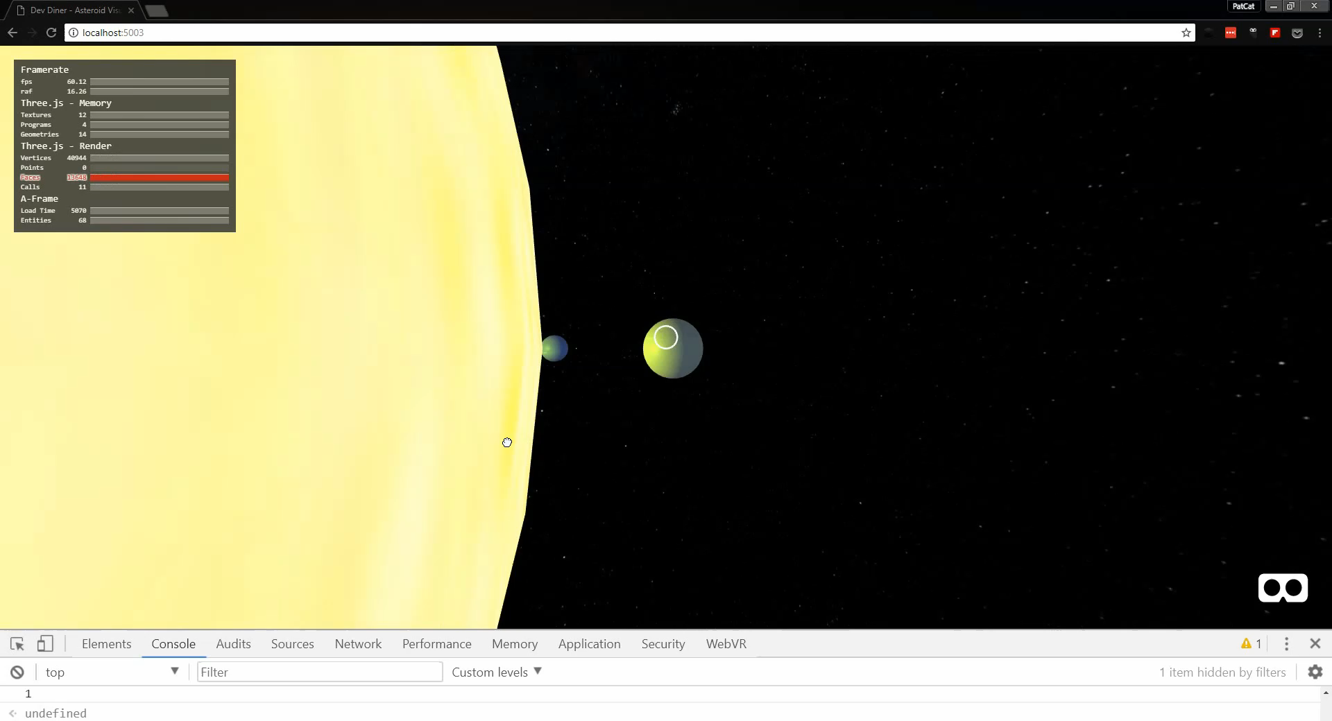

Slide 6
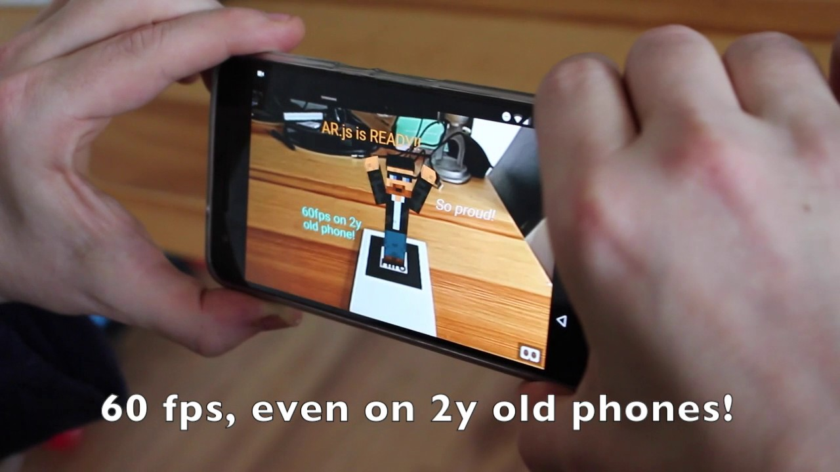

Slide 7

What Next?
Copy directory from USB/Web site
Run through tutorial Readme.pdf
Have fun!

Slide 8

Alex Mackey
Book & Pluralsight Author
Co-organizes DDD Melbourne
Focus on web
Lead consultant at Readify

Slide 9
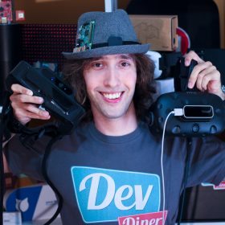
Patrick Catanzariti
Founder of Dev Diner helping developers keep up with emerging tech!
Runs a weekly emerging tech newsletter
VR, AR, IoT and AI developer
Online course and tech article author

Slide 10
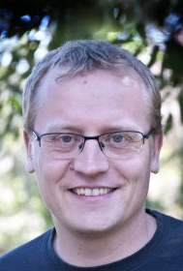
Lars Klint
Author, Trainer, Microsoft MVP
Focus on Hololens & MR
Pluralsight Author
Co-organize DDD Melbourne
Freelance consultant

Slide 11
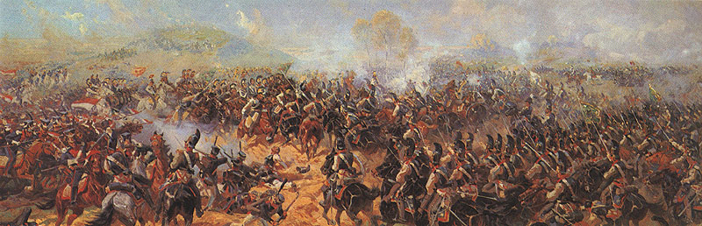
https://en.wikipedia.org/wiki/Panoramic_painting#/media/File:Battery_of_Raevsky.jpg

Slide 12
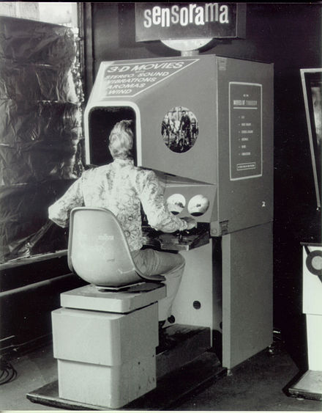
Sensorama (1962)
Created by Morton Heilig
Speakers, stereoscope 3D display, vibrating chair, fans & “smell generator”
6 films including – “I’m a coca cola bottle”
https://en.wikipedia.org/wiki/Sensorama

Slide 13
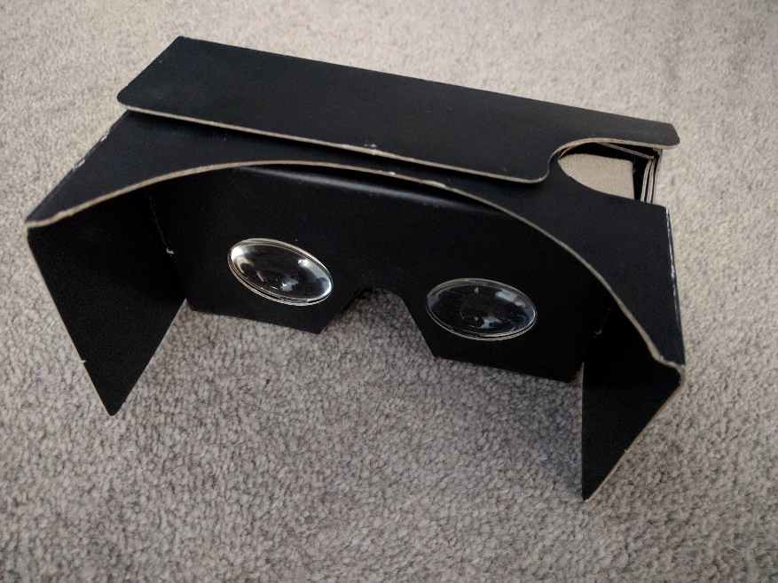
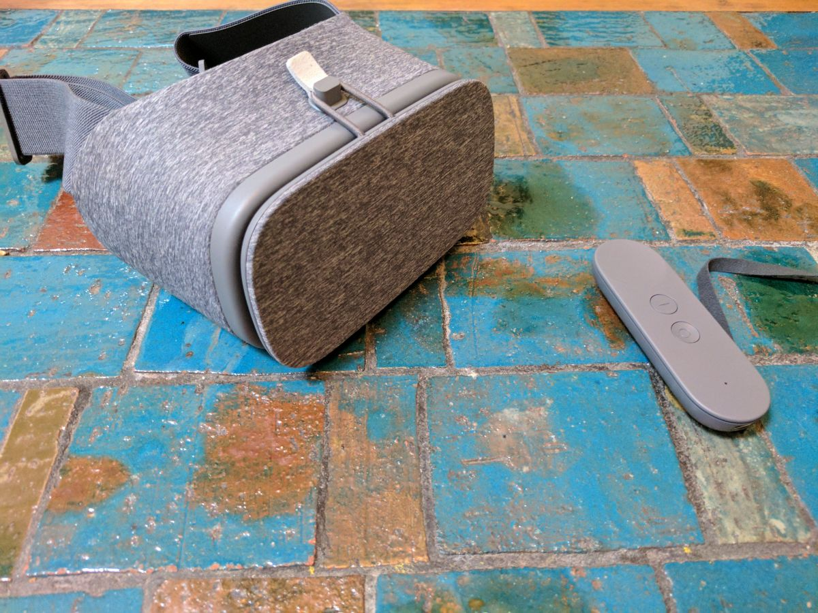
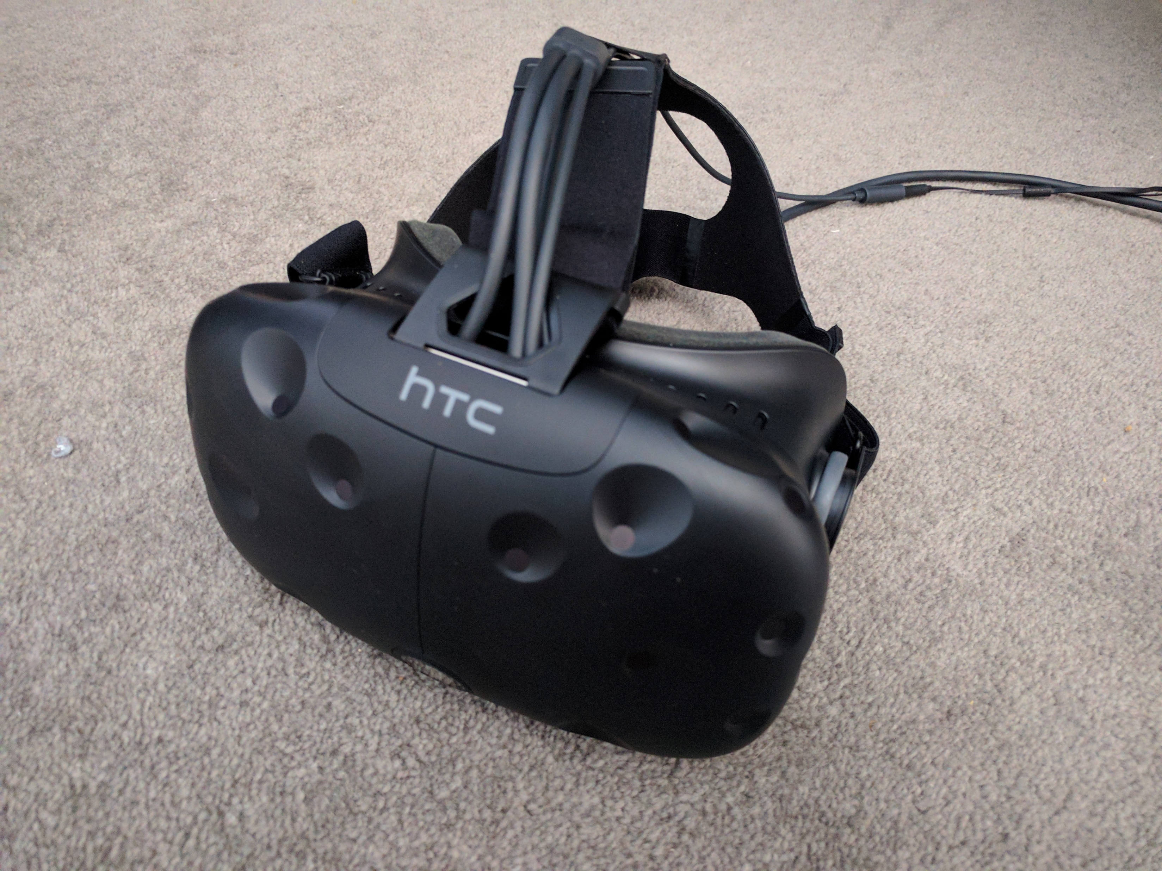
Devices

Slide 14
VR Development Options
Web
1
Unity
2
Cardboard SDK
3
Game Engines
4

Slide 15

Why Web?

Slide 16
Reasons for
No plug-in required & runs on multiple devices and platforms
Use familiar technologies – JS, HTML etc & make use of existing web libraries
Open distribution* with small application size
Works well on lower spec devices
Prototyping

Slide 17
Reasons against
Less performant to native options
Limited Control integration*
Experimental tech

Slide 18


Slide 19
Web based VR Ingredients
JavaScript
Web.GL
Three.JS
WebVR
Device Orientation Events

